Slide 1
GGC Maps: Final Report
By Team Vegan’t

Slide 2




Team Vegan’t
Marcelo Mariduena
Team Manager
UI/UX Designer
Jonathan Mwizerwa
Lead Programmer
UI/UX Designer
Graham Giles
Quality Assurance
Client Liaison
Philip Wall
Data Modeling
Documentation Lead

Slide 3


Our Clients
Mike Deiters
Founder of GGC-Maps
David Rivera
Lead Contributor of GGC-Maps
Internet Ghost

Slide 4
Features Implemented
Fire Escape Routes
Adobe Illustrator was used to draw the routes onto a new layer of the original designated floor file
One can find a toggle button on the bottom left of the side menu of GGC-Maps app. Switching it 'on' when in a floor shows the fire escape routes one can take.
Major files changed to implement this feature included: index.html, /Building/*
Files added: /lib/scripts-js/showHideFireRoutes.js
Routes From Building to Building and Estimated Travel Times
Adobe Illustrator was again used to draw walking routes onto various new layers in the original campus map file.
One can find a toggle button on the bottom left of the side menu of GGC-Maps app. Switching it 'on' when in the campus map page shows 2 drop down menus you can select to see the approximate time it takes.
Files added: lib/scripts-js/showHideTravelTimes.js
Added Dining Services Pane For Dining Menus and Hours
One can find a toggle button on the bottom left of the side menu of GGC-Maps app. Switching it 'on' in any page shows a small menu to the right displaying dining location information from GGC’s website.
Major files changed to implement this feature included: index.html (added IFrames element for this).

Slide 5
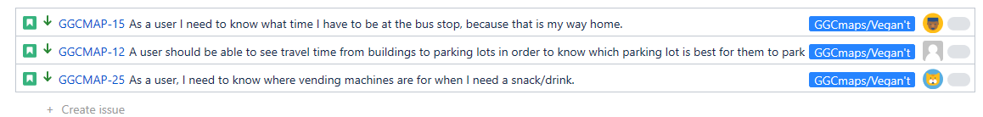
Not Implemented
Luckily they were low priority and left for last!

Slide 6
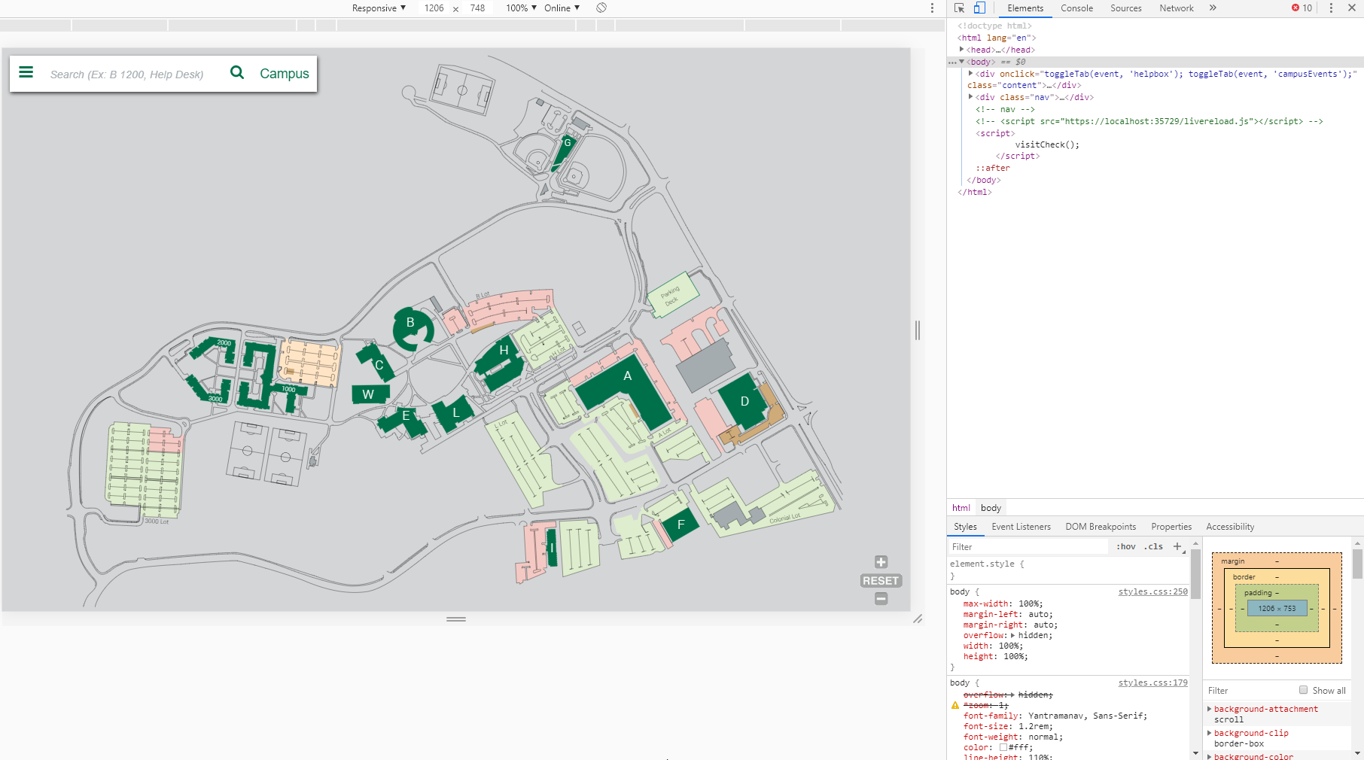
Testing
Mostly testing the site itself to see if anything would break when using it
Browserstack can help with testing on other platforms (certain phones/etc.)
Graham used Selenium to automate some of the computer browser testing

Slide 7
Known Issues
Toggle buttons do not reset themselves when navigating through rooms/buildings

Slide 8
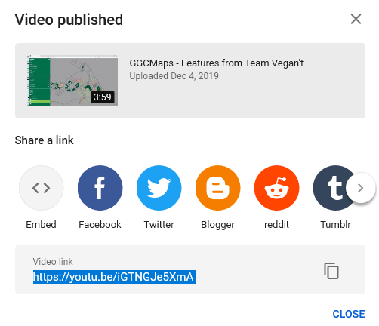
Product Demo
https://youtu.be/iGTNGJe5XmA
The general reaction we received at CREATE was positive and enthusiastic towards the project in general as well as the changes we added. Many stated they thought it’d be useful to new students during orientation.

Slide 9
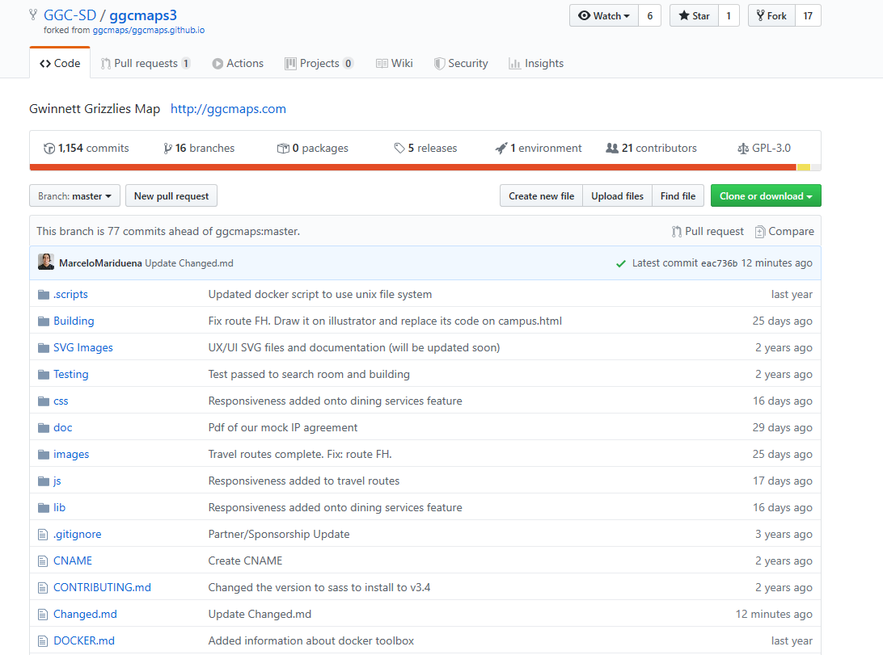
Final Product Location
The final product repo can be found at: https://github.com/GGC-SD/ggcmaps3
Our project documentation is located in the repo stated above under the Changed.md file

Slide 10
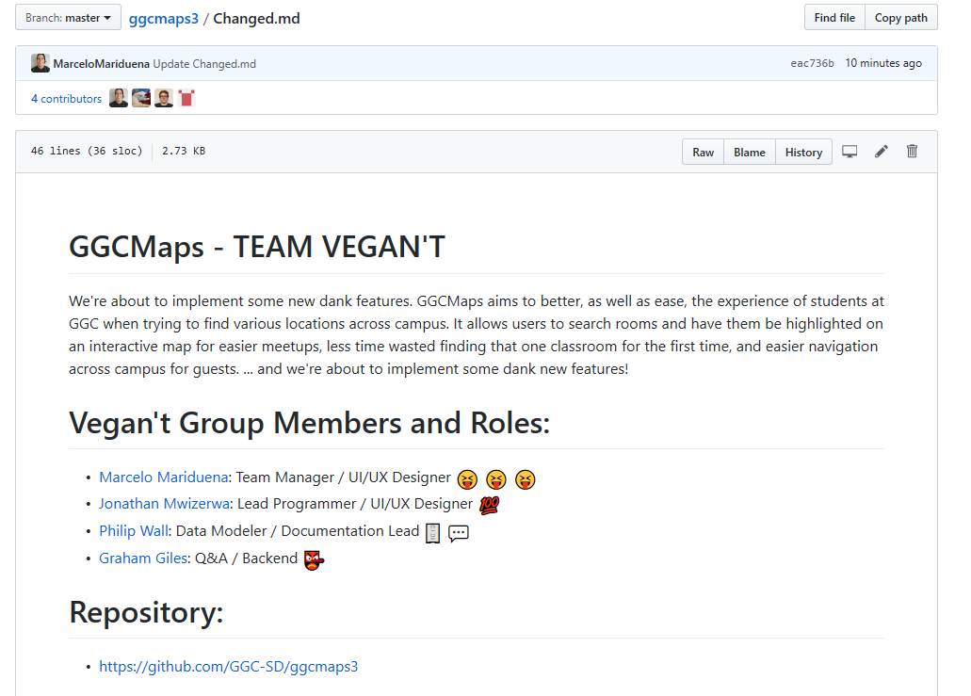
Documentation Page
https://github.com/GGC-SD/ggcmaps3/blob/master/Changed.md

